Slide 1
Division Operation
Suited to queries that include the phrase “for all”.
Division is typically required when you want to find out entities that are interacting with all entities of a set of different type entities
Some instances where division operator is used are:
Which person has account in all the banks of a particular city?
Which students have taken all the courses required to graduate?
Important: Division is not supported by SQL implementations. However, it can be represented using other operations.(like cross join, Except, In )

Slide 2
Division Operation
r ÷ s
Let r and s be relations on schemas R and S respectively
  R = (A₁, …, A_{m} , B₁, …, B_{n} )
  S = (B₁, …, B_{n})
  The result of r ÷ s is a relation on schema
  R – S = (A₁, …, A_{m})
  r ÷ s = { t | t ∈ ∏ _{R-S} (r) ∧ ∀ u ∈ s ( tu ∈ r ) }
  * u representing any tuple in s
  Where tu means the concatenation of a tuple t and u to produce a single tuple
  * for every tuple in R-S (called t), there are a set of tuples in R, such that for all tuples (such as u) in s, the tu is a tuple in R.

Slide 3
Division Operation – Example
Relations r, s:
A
B
B
α
α
α
β
γ
δ
δ
δ
∈
∈
β
1
2
3
1
1
1
3
4
6
1
2
1
2
s
e.g.
A is customer name
B is branch-name
1and 2 here show two specific branch-names
(Find customers who have an account in all branches of the bank)
r ÷ s:
A
r
α
β

Slide 4
Another Division Example
Relations r, s:
A
B
C
D
E
D
E
α
α
α
β
β
γ
γ
γ
a
a
a
a
a
a
a
a
α
γ
γ
γ
γ
γ
γ
β
a
a
b
a
b
a
b
b
1
1
1
1
3
1
1
1
a
b
1
1
s
r
e.g.
Students who have taken both "a” and “b” courses, with instructor “1”
(Find students who have taken all courses given by instructor 1)
r ÷ s:
A
B
C
α
γ
a
a
γ
γ

Slide 5
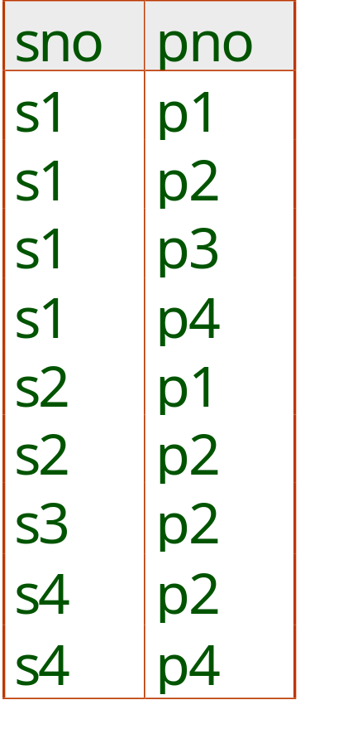
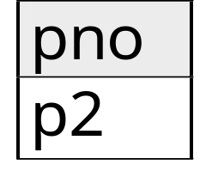
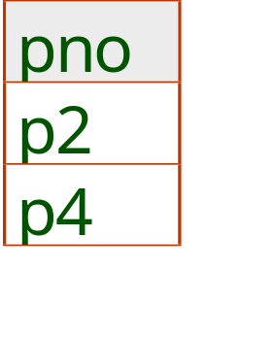
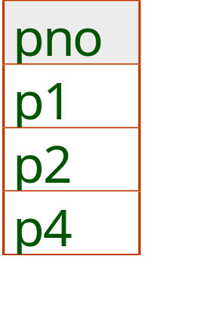
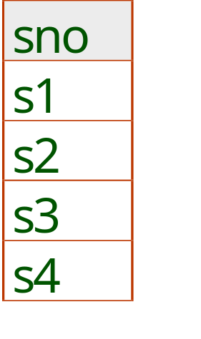
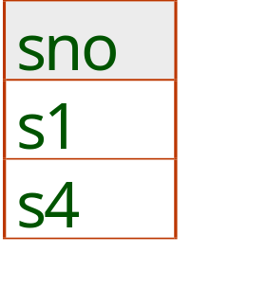
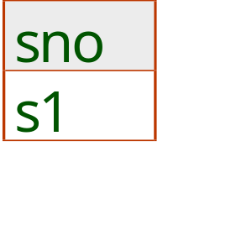
Examples of Division A/B
B1
B2
B3
A
A/B1
A/B2
A/B3
Notes:
14

Slide 6
Examples of Division A/B
B1
B2
B3
A
A/B1
A/B2
A/B3
Notes:
14

Slide 7
Assignment Operation
Example of writing division with set difference, projection, and assignments: r ÷ s
temp1 ← ∏R-S (r )
temp2 ← ∏R-S ((temp1 x s ) – ∏R-S,S (r ))
result = temp1 – temp2
  The result to the right of the ← is assigned to relation variable on the left of the ← .
  May use variables in subsequent expressions
  * Try executing the above query at home on the previous example, to convince yourself about its equivalence to the division operation

